Slide 1
G M T S S
THE GLOBAL MEETING, TRAINING,
AND SEMINAR SYSTEM

Slide 2
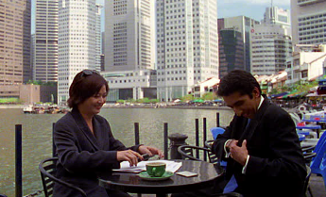
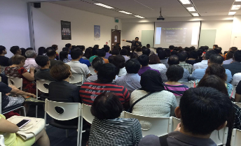
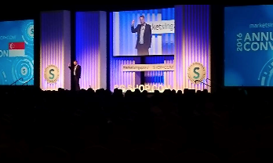
GMTSS COMPONENTS
One-on-one / Two-on-one
Home Business Presentation
UnFranchise® Business Presentation & Essential Trainings
Local Seminars and Events

Slide 3
Health
& Nutrition
Skincare
& Cosmetics
TLS™ - Weight
Management
Internet
Sales & Marketing
Webcenters™
1 on 1s
2 on 1s
HBP
UBP
NUOT, B5, ECCT
Local Seminar
Annual Convention & Leadership School
International Convention & World Conference

Slide 4
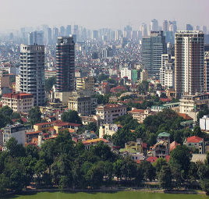
GMTSS BENEFIT
Utilising the
“System”
Sustain, Maintain & Retain
Building in other area

Slide 5
ADDITIONAL BENEFIT
Help Manage Organization Through
CROSS-POLLINATION & TEAMWORK
Leveraging Time
TIME is Money
Building a Nationwide
PRODUCT
DISTRIBUTION
SYSTEM

Slide 6
ADDITIONAL BENEFIT
Global
STANDARDISED TRAINING /
TICKET PRICES
Create
RECOGNITION
SYSTEM
Build
LEADERSHIP /
CAMARADERIE

Slide 7
YOU CAN’T BE A
LEADER
IF YOU’RE NOT PART OF THE
SYSTEM

Slide 8
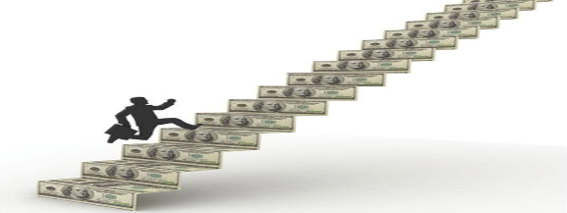
IMPORTANCE OF GMTSS
THE MONEY IS
IN THE PLAN!
NOT THE MEETINGS

Slide 9
STARTING
THE GMTSS SYSTEM
IMPLEMENTING AND DUPLICATING THE SYSTEM

Slide 10
GMTSS GOAL
Implement a professional GMTSS system
Set records for attendance at all meeting levels (UBPs, Trainings)
Increase the number of UFO in SINGAPORE(Increase Recruitment)
Increase #Pin Levels
Increase the number of Preferred Customers (Increase Sales)
Build teamwork

Slide 11
GMTSS Singapore
How do we reach our goals?
More 1 on 1 /2 on 1 /HBP and
Promote team work
Promote and participate in UBP to increase attendees and built momentum
Identify your major and participate in training
Increase
event ticket sales
Duplication

Slide 12
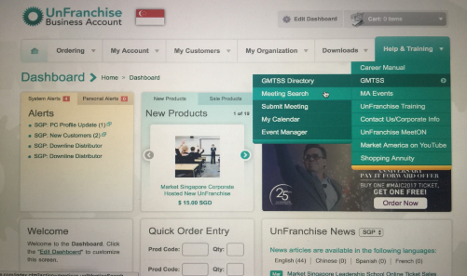
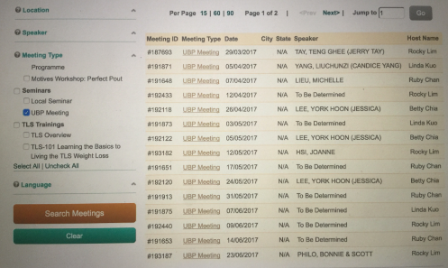
UNFRANCHISE®
SYSTEM
EVENT
CALENDER

Slide 13
FOLLOWING A SYSTEM FOR
SUCCESS
G M T S S

